Slide 1
Elements of WIMP Interface
Week 7

Slide 2
Elements of WIMP Interface
windows, icons, menus, pointers
+++
  buttons,
  toolbars,
  palettes,
  dialog boxes

Slide 3
Windows
Windows
  Areas of the screen that behave as if they were independent;
    can contain text or graphics
    can be moved or resized
    can overlap each other, or can be laid out next to one another (tiled)

Slide 4
Windows
  Scrollbars
    allow the user to move the contents of the window
    up and down or from side to side
  Title bars
    describe the name of the window

Slide 5
Icons
Icons
  Small picture or image
  Represents some object in the interface
    often a window or action

Slide 6
Icons
  windows can be closed down (ionized)
    small representation of many accessible windows
  Icons can be many and various
    highly stylized
    realistic representations.

Slide 7
Pointers
Pointers
  important component
    WIMP style relies on pointing and selecting things
  uses mouse, track pad, joystick, trackball, cursor keys or keyboard shortcuts.

Slide 8
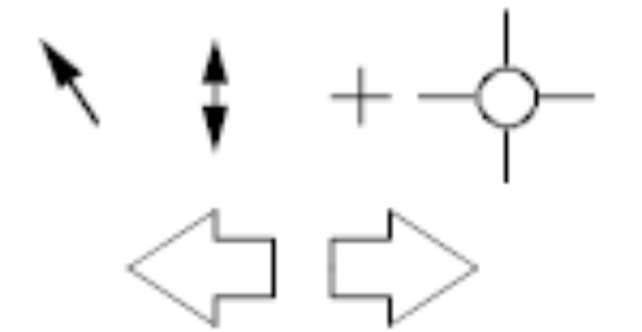
Pointers
  wide variety of graphical images

Slide 9
Menus
Menus
  Choice of operations or services offered on the screen
  Required option selected with pointer

Slide 10
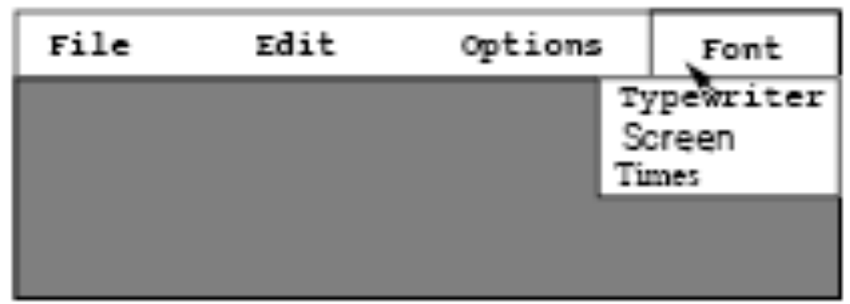
Menus
problem – take a lot of screen space
solution – pop-up: menu appears when needed

Slide 11
Menus
Kinds of Menus
  Menu Bar at top of screen (normally), menu drags down
    pull-down menu - mouse hold and drag down menu
    drop-down menu - mouse click reveals menu
    fall-down menus - mouse just moves over bar!

Slide 12
Menus
  Contextual menu appears where you are
    pop-up menus - actions for selected object
    pie menus - arranged in a circle
      easier to select item (larger target area)
      quicker (same distance to any option)
      … but not widely used!

Slide 13
Menus
Menus design issues
  which kind to use
  what to include in menus at all
  words to use (action or description)
  how to group items

Slide 14
Buttons
Buttons
  individual and isolated regions within a display that can be selected to invoke an action.

Slide 15
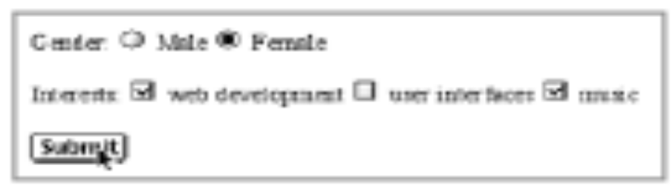
Buttons
Special kinds
– radio buttons
– set of mutually exclusive choices
– check boxes
– set of non-exclusive choices

Slide 16
Toolbars
Toolbars
  long lines of icons …
  fast access to common actions
  often customizable:
    choose which toolbars to see
    choose what options are on it

Slide 17
Plaettes
Palettes
  Problem
    menu not there when you want it
  Solution
    palettes – little windows of actions
      shown/hidden via menu option.
        e.g. available shapes in drawing package

Slide 18
Dialogue Boxes
Dialogue boxes
  information windows that pop up to inform of an important event or request information.
    e.g: when saving a file, a dialogue box is displayed to allow the user to specify the filename and location. Once the file is saved, the box disappears.

